Slide 1
The Rhoking Goddess of water
Or what happened when they went away with a feeling of accomplishment.

Slide 2
25 Word Abstract
Nonprofit are working hard digging wells, but who does the maintenance once they are gone? This is a game about people taking power in their own hands.

Slide 3
Premise
There was a little village on a mountain far far away.
International help came and drill some wells to help them improve their quality of life. Construction was quick and efficient, a lot of money was invested.

Slide 4
Premise
At first, the citizens where super happy: everyone could get water with a lot less effort, watering the crops was easier, even the health status was slowly improving.
Everything was perfect...
Even people from smaller villages started moving in to enjoy this amazing new resource. Once again, the generous sponsors saved the game! They smiled, congratulated each others and went back to where they came from...

Slide 5
Premise
Then, little by little, the equipment started wearing off; a little leak here, a loose pump there. It was a little less efficient but still functional. People thought it was normal; they didn’t care because international help would come back to help them soon right?
But international help reached its maximal allowed investment in this sector and they had to go somewhere else to ‘’help’’ more people.

Slide 6
Premise
Overwhelmed by the technology, people preferred to go back to their old ways than trying to fix the system that was making their life easier.
After all, they lived without it since the dawn of times... Women went back to the well... Everyday... long hours of walk... no time for school or work anymore...

Slide 7
Premise
One little girl said NO!

Slide 8
Characters
The Mayor:
He is very busy dealing with the social problems created by the water shortage. In fact he is so busy fixing symptoms, he don’t see how they are all linked together.
The little Girl:
She is the daughter of the mayor. She is one of the lucky little girls who got admitted in school after the “water revolution”. She disagrees with her father’s decision to go back to the ancestral way of life. She wants to fix the broken system.
The Villager:
They are scared, thirsty and disillusioned. After a very short golden age, they are left resourceless and despaired in an arid aftermath.

Slide 9
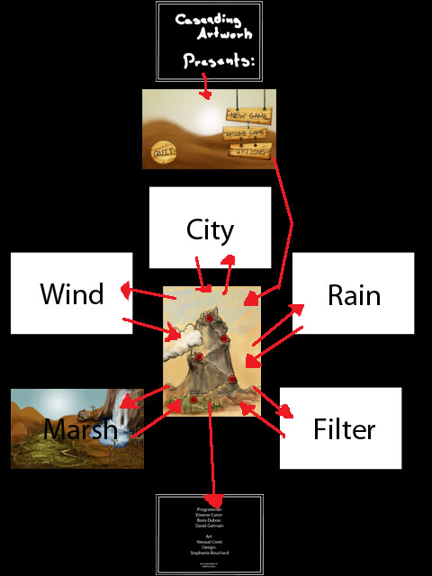
Gameplay
Game Flow Chart:
Team Splash Screen
Main Menu
Intro Story Section
Level Selection Menu
Level1 – The city
Level2 – The Marsh
Level3 – The filtering plant
Level4 – Rainmakers
Level5 – Wind Wakers
Super Amazing Finally with lasers!
Credits

Slide 10
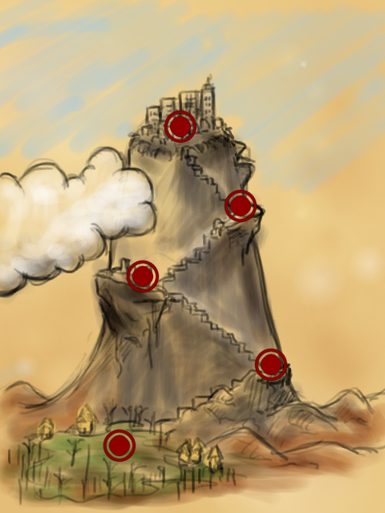
Gameplay
Plot:
After fixing the City’s pipe system, the citizens quickly figure out that the problem seems to come from somewhere else. The little girl have to visit other levels to figure out what’s going on.
Fixing the different sub-parts of the system will bring water to other levels, increasing the amount of water pumped improve the water pressure and the life of the little villages around the city.
The user is rewarded by a greenification of the scenery in the level selection screen plus amazing water based visual effects.

Slide 11
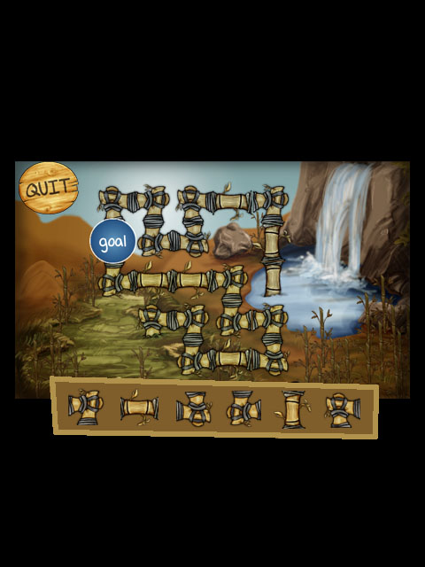
Gameplay
The game is based on a typical ‘’pipe puzzle game’’ mechanics:
Each a 6 x 5 puzzle grid
6 types of pipe puzzle pieces.
One or more water source per level.
One or more water pipeline gate per level.
Water pumps
Filtering units

Slide 12
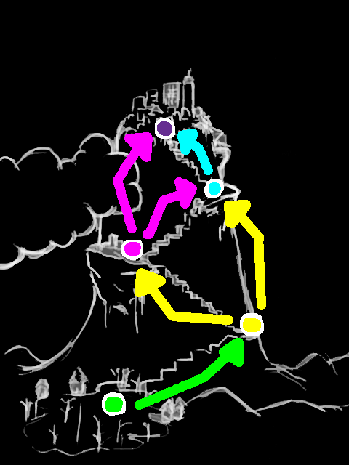
Gameplay
The game is based on a typical ‘’pipe puzzle game’’ mechanics:
5 interconnected levels [Puzzles inside puzzles]
Pick tubes from the inventory to place on the puzzle grid.
Tubes can be picked back up to be put somewhere else.
Tubes can be carried from one level to another.
Some tubes are static and cannot be moved blocking some grid case, same for natural elements like trees and rocks.

Slide 13
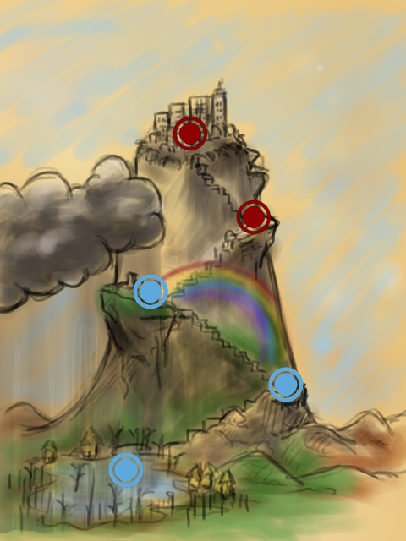
Gameplay
Plot:
After fixing the City’s pipe system, the citizens quickly figure out that the problem seems to come from somewhere else. The little girl have to visit other levels to figure out what’s going on.
Fixing the different sub-parts of the system will bring water to other levels, increasing the amount of water pumped improve the water pressure and the life of the little villages around the city.
The user is rewarded by a greenification of the scenery in the level selection screen plus amazing water based visual effects.

